Slide 1
Parallel programming languages and Models

Slide 2
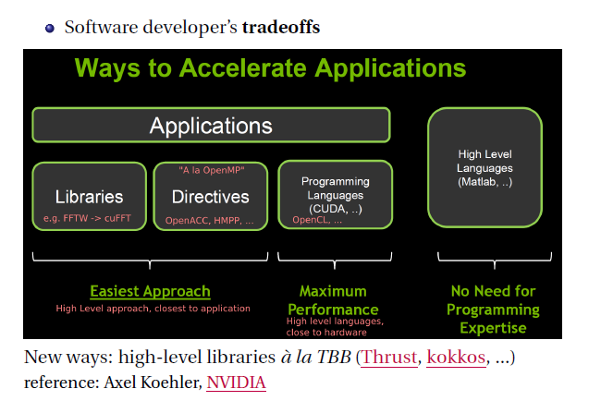

Slide 3
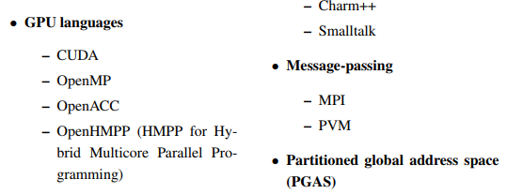

Slide 4
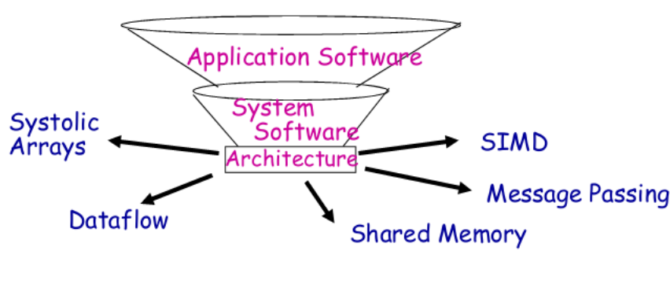

Slide 5
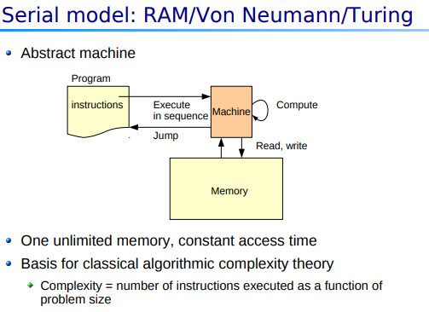

Slide 6
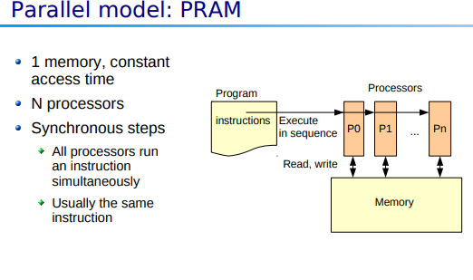

Slide 7
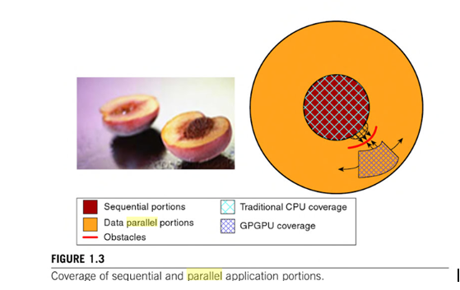

Slide 8
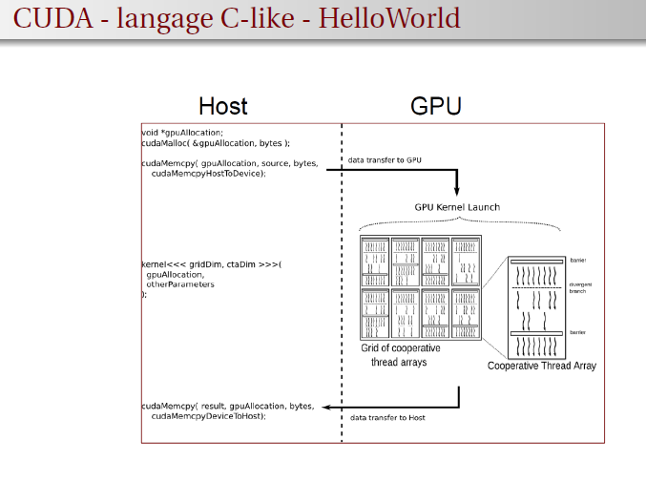

Slide 9
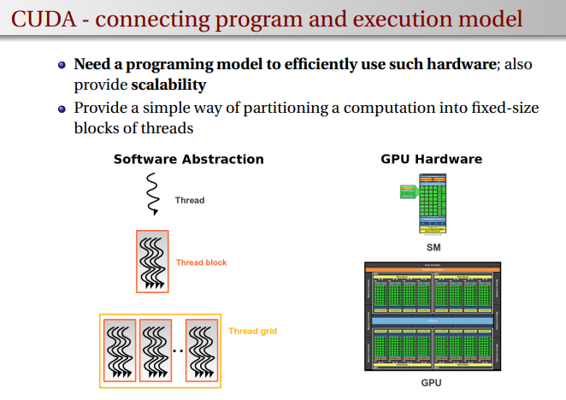

Slide 10
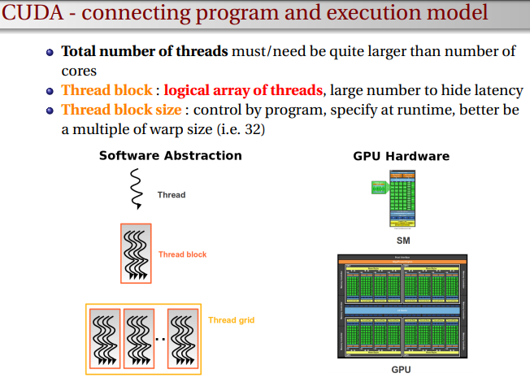

Slide 11
Programming Models
Parallel Programming Models
➢ Message passing • Independent tasks encapsulating local data • Tasks interact by exchanging messages
➢ Shared memory • Tasks share a common address space • Tasks interact by reading and writing this space asynchronously
➢ Data parallelization • Tasks execute a sequence of independent operations • Data usually evenly partitioned across tasks • Also referred to as “embarrassingly parallel”

Slide 12


Slide 13
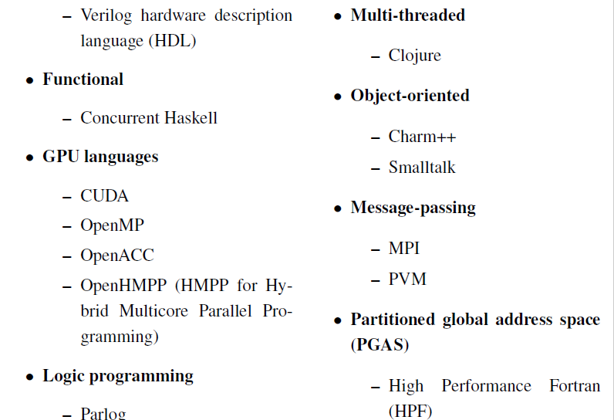

Slide 14
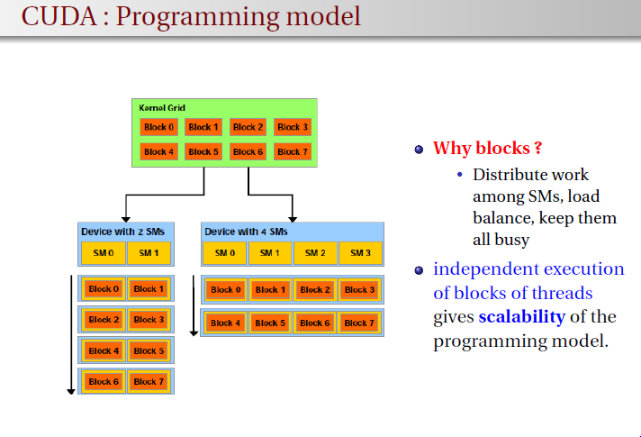

Slide 15
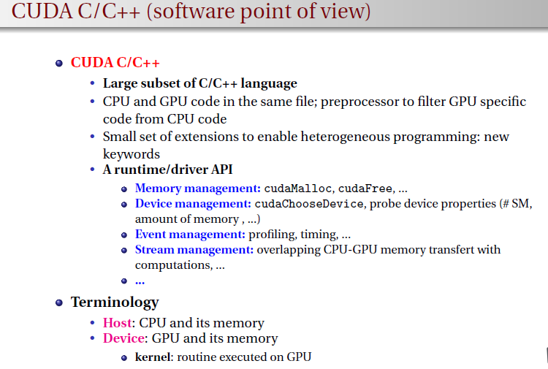

Slide 16
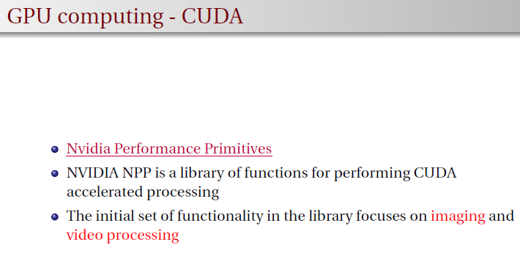

Slide 17
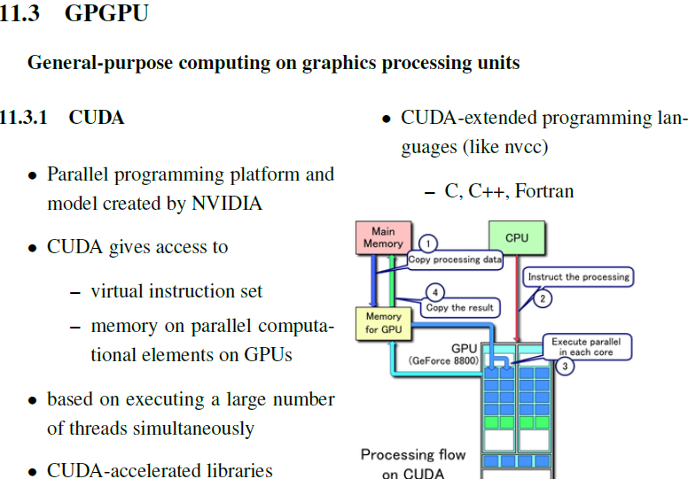

Slide 18
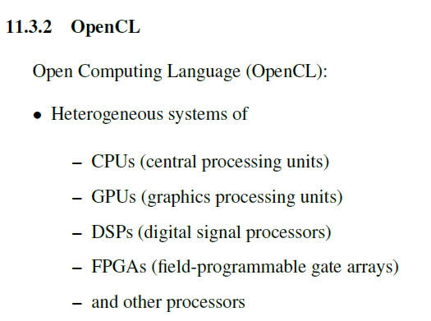

Slide 19
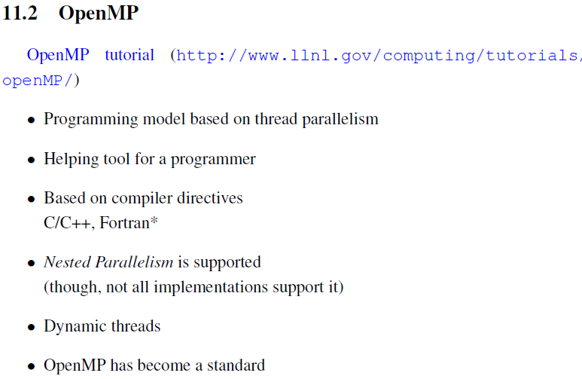

Slide 20
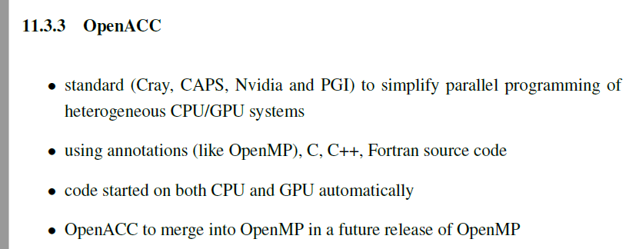

Slide 21
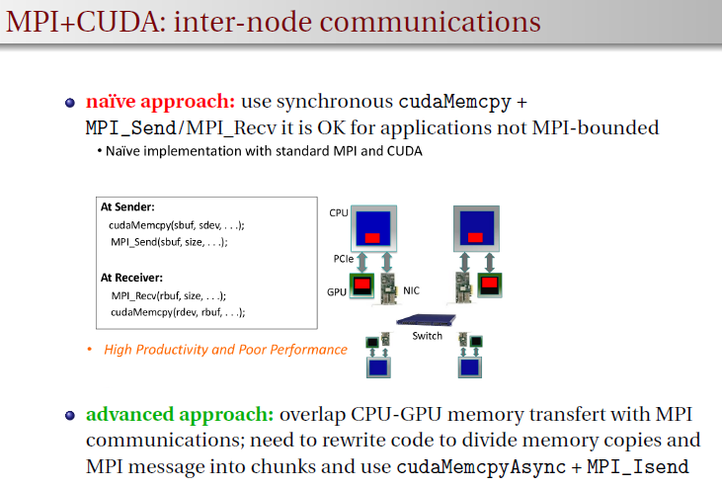

Slide 22
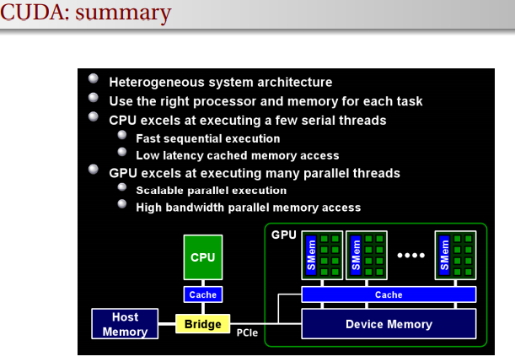

Slide 23
